Slide 1
Modelling Colombian Economy: Stock-Flow Consistent Prototype Growth Model
An adaptation from Yilmaz & Godin (2020).

Slide 2
Structure of the presentation.
Discussion about last meeting comments: FX loans, portfolio flows, consumption tax, households equities, and labour productivity.
Summary of the final version of the model.
Once the model is in the code, what alternatives scenarios to include.

Slide 3
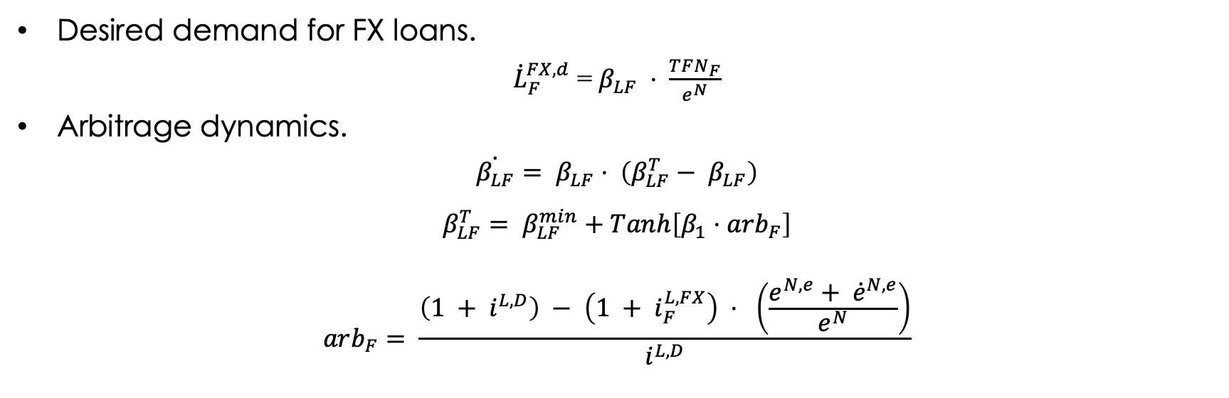
FX loans – Demand.
Desired demand for FX loans.
${\dot{L}}_{F}^{FX,d}$ = $β_{LF} ⋅ \frac{TFN_{F}}{e^{N}}$
Arbitrage dynamics.
$$\dot{β_{LF}}= β_{LF}⋅ \left(β_{LF}^{T}− β_{LF}\right)$$
$$β_{LF}^{T}= β_{LF}^{min}+Tanh\left[β_{1}⋅arb_{F}\right]$$
$$arb_{F}= \frac{\left(1 + i^{L,D}\right) − \left(1 + i_{F}^{L,FX}\right) ⋅ \left(\frac{e^{N,e}+ {\dot{e}}^{N,e}}{e^{N}}\right)}{i^{L,D}}$$

Slide 4
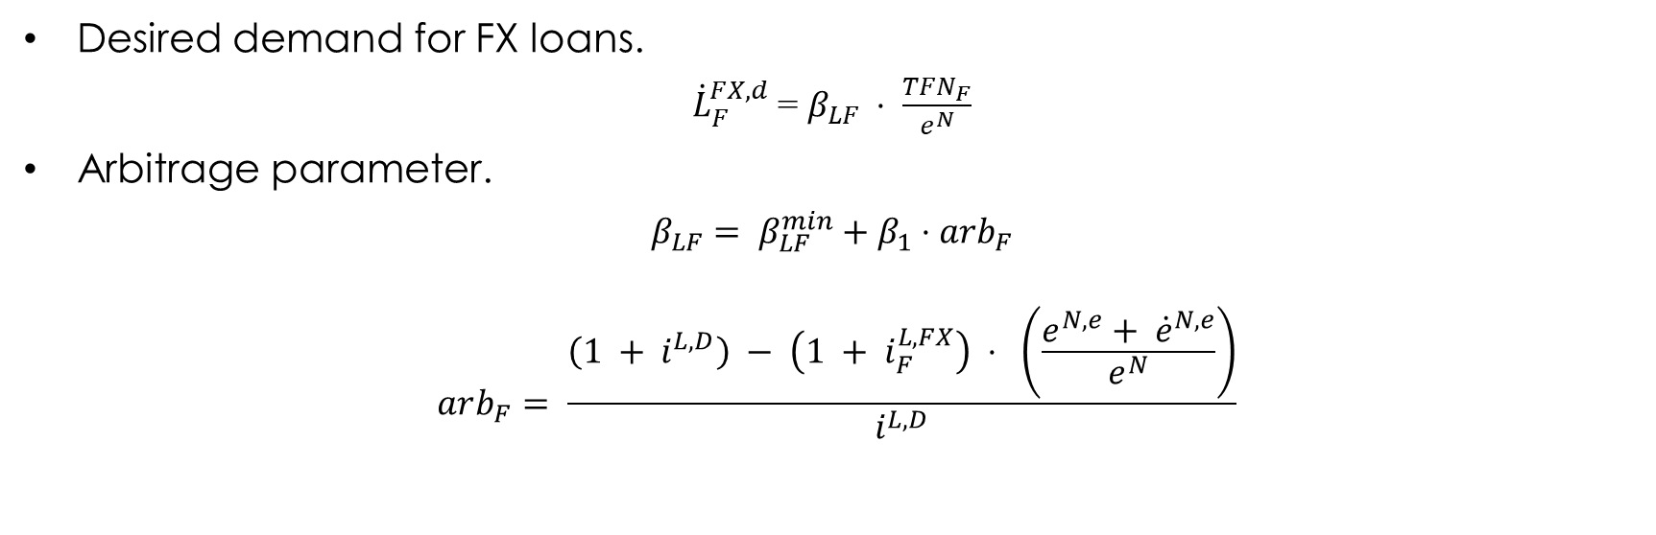
FX loans – New Arbitrage Dynamic.
Desired demand for FX loans.
${\dot{L}}_{F}^{FX,d}$ = $β_{LF} ⋅ \frac{TFN_{F}}{e^{N}}$
Arbitrage parameter.
$$β_{LF}= β_{LF}^{min}+β_{1}⋅arb_{F}$$
$$arb_{F}= \frac{\left(1 + i^{L,D}\right) − \left(1 + i_{F}^{L,FX}\right) ⋅ \left(\frac{e^{N,e}+ {\dot{e}}^{N,e}}{e^{N}}\right)}{i^{L,D}}$$

Slide 5

Firms FX loans – Supply.
Credit rationing mechanism applied by the international banks:
${\dot{L}}_{B}^{FX,d}= {\dot{L}}_{F}^{FX,d}$
$${\dot{L}}_{B}^{FX}= {χ∙\dot{L}}_{B}^{FX,d}$$
$$χ= χ_{0}+χ_{1}∙NIIP+ χ_{2}∙\frac{\dot{GDP}}{GDP}$$
Interest rate on FX loans charged to the domestic banks
$i_{B}^{L,FX}= \left(1+θ\right)i^{W}$
$$θ= θ_{0}∙risk$$

Slide 6

Portfolio Flows – Option A.
Portfolio flows entering to the economy
$$WFF^{D}= ψ∙{\dot{B}}_{G}/e^{N}$$
$$ψ=ψ_{min}+ψ_{1}∙\left(r^{B,e}−r^{W, e}\right)$$
$$r_{G}^{B,e}= \frac{\left(1 +i_{G}^{B} \right)\left(1 − rsk\right)}{\left(\frac{e^{N,e} + {\dot{e}}^{N,e}}{e^{N}}\right)}$$
$$r^{W,e}=1+i_{G}^{W}$$
New Government bonds purchased by the rest of the world.
$${\dot{B}}_{G}^{W}=WFF^{D}∙e^{N}$$

Slide 7

Portfolio Flows – Option B.
Global portfolio flows.
$$WFF=Φ⋅GDP_{W}⋅p_{W}$$
Portfolio flows entering to the economy.
$$WFF^{D}=ψ_{WFF}⋅WFF$$
$$ψ_{WFF}=ψ_{min}+ψ_{1}∙\left(r^{B,e}−r^{W, e}\right)$$
$$r_{G}^{B,e}= \frac{\left(1 +i_{G}^{B} \right)\left(1 − rsk\right)}{\left(\frac{e^{N,e} + {\dot{e}}^{N,e}}{e^{N}}\right)}$$
$$r^{W,e}=1+i_{G}^{W}$$
New Government bonds purchased by the rest of the world.
$${\dot{B}}_{G}^{W}=WFF^{D}∙e^{N}$$

Slide 8
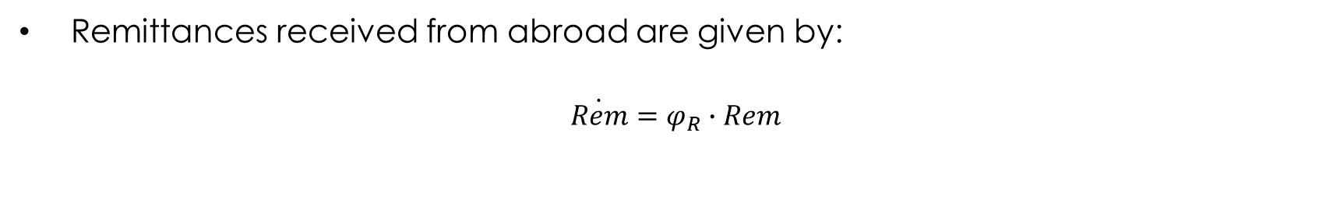
Remittances.
Remittances received from abroad are given by:
$$\dot{Rem}=φ_{R}∙Rem$$

Slide 9
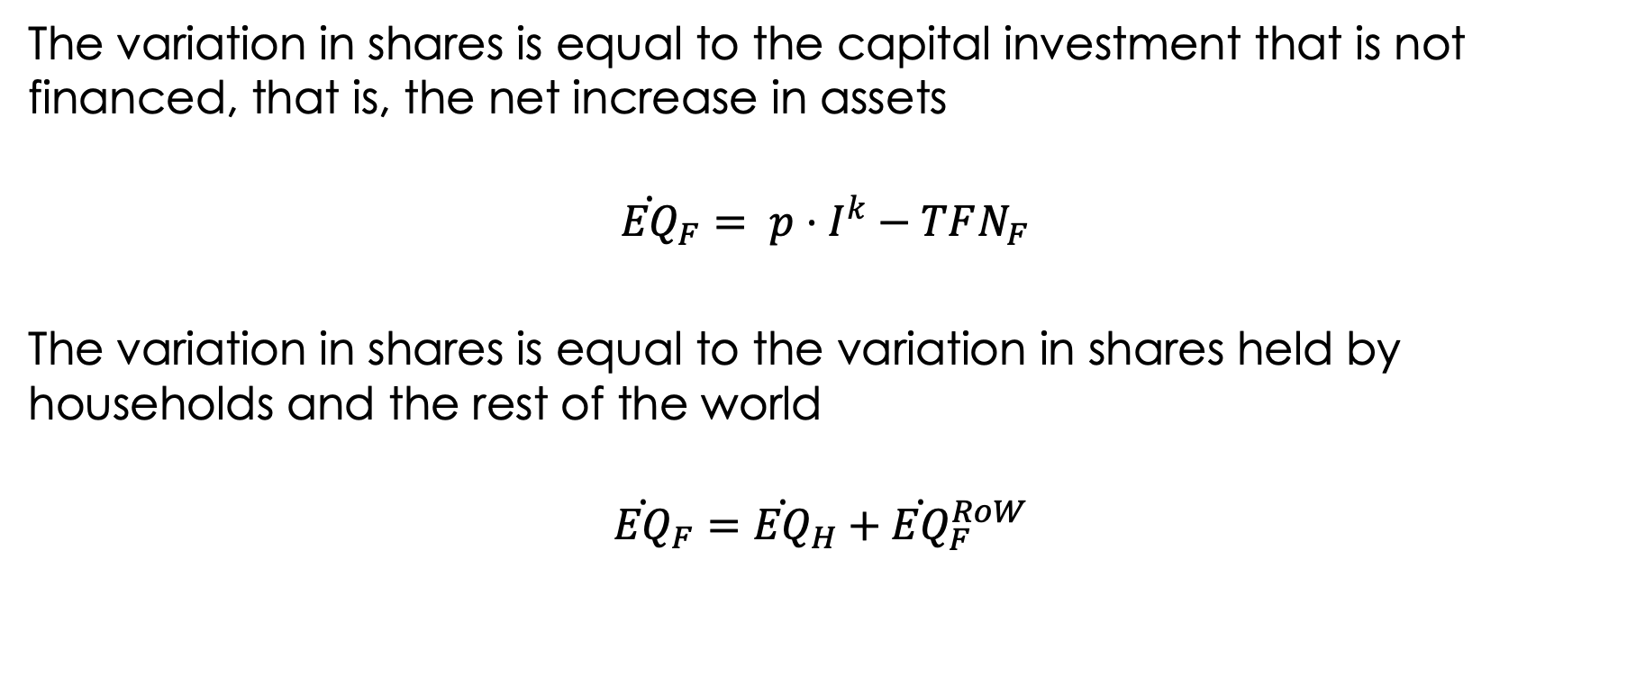
The variation in shares is equal to the capital investment that is not financed, that is, the net increase in assets
$${\dot{EQ}}_{F}= p⋅I^{k}−TFN_{F}$$
The variation in shares is equal to the variation in shares held by households and the rest of the world
$${\dot{EQ}}_{F}={\dot{EQ}}_{H}+{\dot{EQ}}_{F}^{RoW}$$

Slide 10
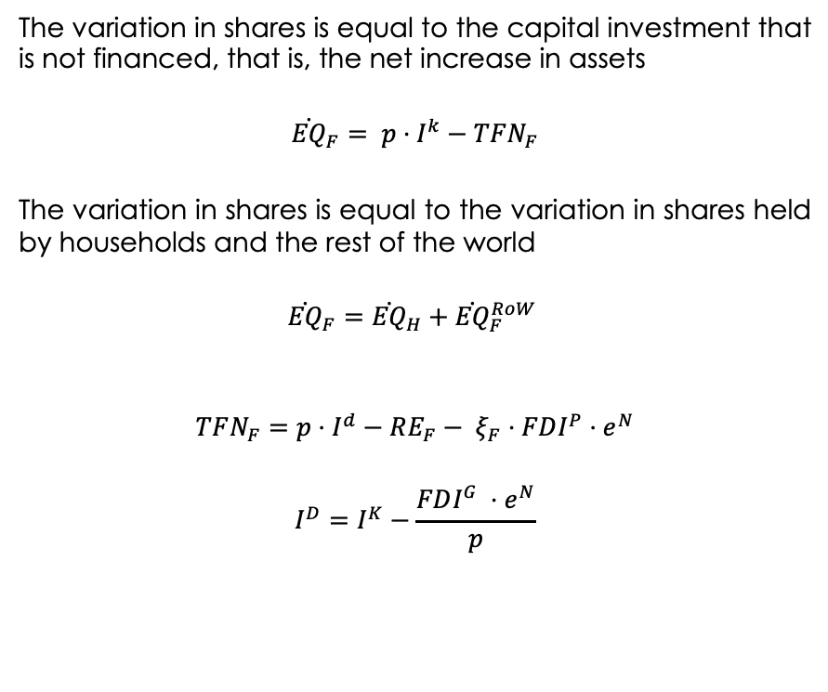
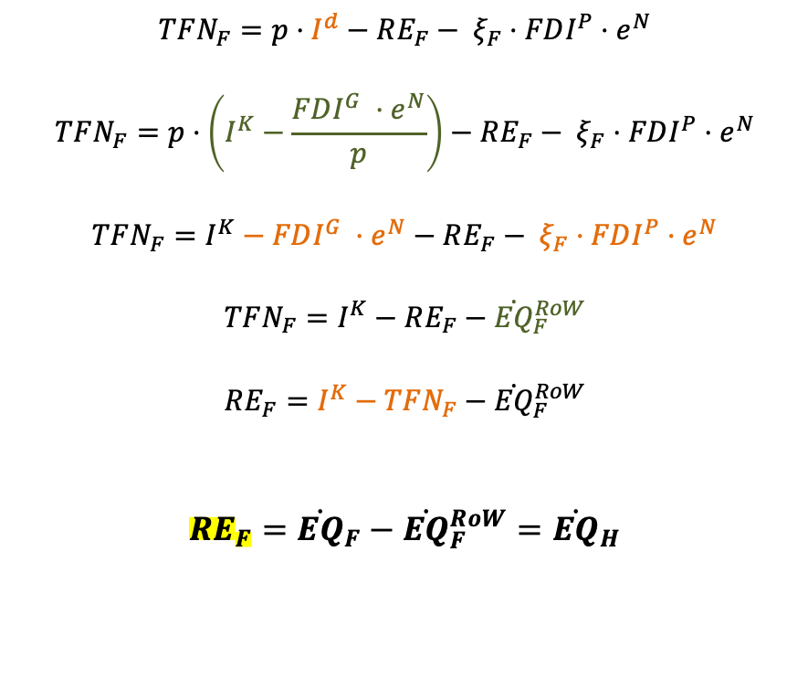
Foreign Firect Investment and shares (Firms)
The variation in shares is equal to the capital investment that is not financed, that is, the net increase in assets
$${\dot{EQ}}_{F}= p⋅I^{k}−TFN_{F}$$
The variation in shares is equal to the variation in shares held by households and the rest of the world
$${\dot{EQ}}_{F}={\dot{EQ}}_{H}+{\dot{EQ}}_{F}^{RoW}$$
$$TFN_{F}=p⋅I^{d}−RE_{F}− ξ_{F}⋅FDI^{P}⋅e^{N}$$
$$I^{D}=I^{K}−\frac{FDI^{G} ⋅e^{N}}{p}$$
$$TFN_{F}=p⋅I^{d}−RE_{F}− ξ_{F}⋅FDI^{P}⋅e^{N}$$
$$TFN_{F}=p⋅\left(I^{K}−\frac{FDI^{G} ⋅e^{N}}{p}\right)−RE_{F}− ξ_{F}⋅FDI^{P}⋅e^{N}$$
$$TFN_{F}=I^{K}−FDI^{G} ⋅e^{N}−RE_{F}− ξ_{F}⋅FDI^{P}⋅e^{N}$$
$$TFN_{F}=I^{K}−RE_{F}−{\dot{EQ}}_{F}^{RoW}$$
$$RE_{F}=I^{K}−TFN_{F}−{\dot{EQ}}_{F}^{RoW}$$
$$RE_{F}={\dot{EQ}}_{F}−{\dot{EQ}}_{F}^{RoW}={\dot{EQ}}_{H}$$

Slide 11
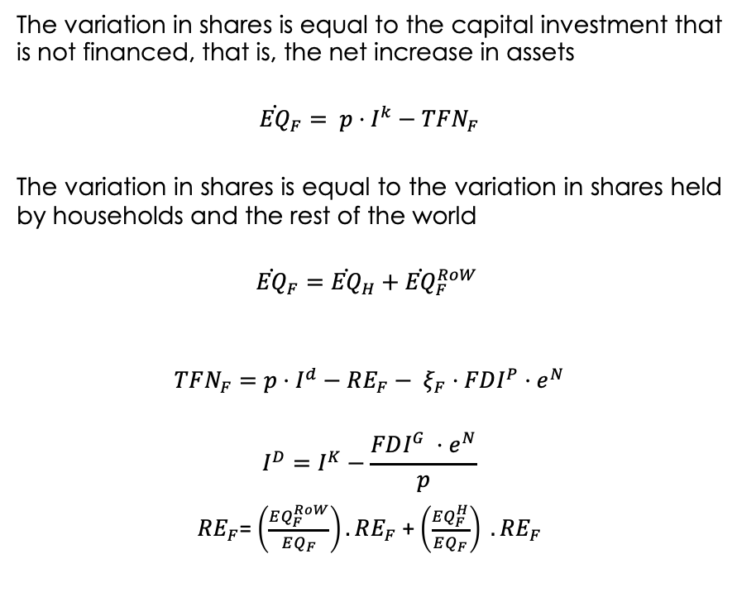
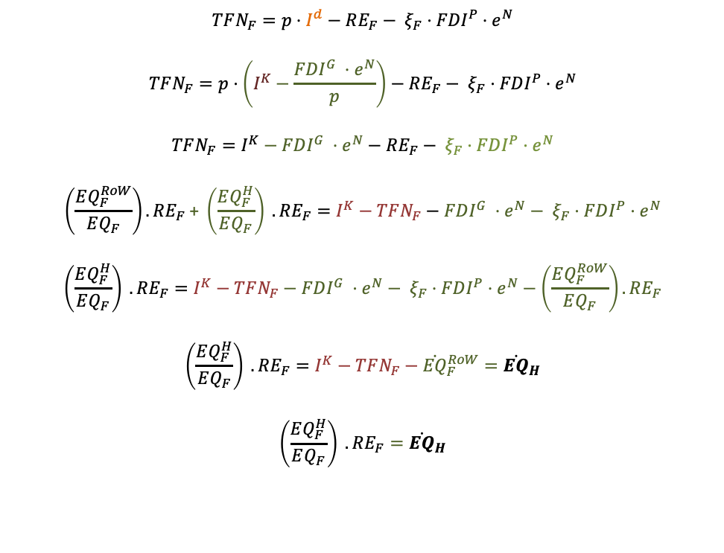
Foreign Firect Investment and shares (Firms)
The variation in shares is equal to the capital investment that is not financed, that is, the net increase in assets
$${\dot{EQ}}_{F}= p⋅I^{k}−TFN_{F}$$
The variation in shares is equal to the variation in shares held by households and the rest of the world
$${\dot{EQ}}_{F}={\dot{EQ}}_{H}+{\dot{EQ}}_{F}^{RoW}$$
$$TFN_{F}=p⋅I^{d}−RE_{F}− ξ_{F}⋅FDI^{P}⋅e^{N}$$
$$I^{D}=I^{K}−\frac{FDI^{G} ⋅e^{N}}{p}$$
$RE_{F}$= $\left(\frac{EQ_{F}^{RoW}}{EQ_{F}}\right).RE_{F}$ + $\left(\frac{EQ_{F}^{H}}{EQ_{F}}\right) .RE_{F}$
$$TFN_{F}=p⋅I^{d}−RE_{F}− ξ_{F}⋅FDI^{P}⋅e^{N}$$
$$TFN_{F}=p⋅\left(I^{K}−\frac{FDI^{G} ⋅e^{N}}{p}\right)−RE_{F}− ξ_{F}⋅FDI^{P}⋅e^{N}$$
$$TFN_{F}=I^{K}−FDI^{G} ⋅e^{N}−RE_{F}− ξ_{F}⋅FDI^{P}⋅e^{N}$$
$$\left(\frac{EQ_{F}^{RoW}}{EQ_{F}}\right).RE_{F} \text{+} \left(\frac{EQ_{F}^{H}}{EQ_{F}}\right) .RE_{F}=I^{K}−TFN_{F}−FDI^{G} ⋅e^{N}− ξ_{F}⋅FDI^{P}⋅e^{N}$$
$$\left(\frac{EQ_{F}^{H}}{EQ_{F}}\right) .RE_{F}=I^{K}−TFN_{F}−FDI^{G} ⋅e^{N}− ξ_{F}⋅FDI^{P}⋅e^{N}−\left(\frac{EQ_{F}^{RoW}}{EQ_{F}}\right).RE_{F}$$
$$\left(\frac{EQ_{F}^{H}}{EQ_{F}}\right) .RE_{F}=I^{K}−TFN_{F}−{\dot{EQ}}_{F}^{RoW}={\dot{EQ}}_{H}$$
$$\left(\frac{EQ_{F}^{H}}{EQ_{F}}\right) .RE_{F}={\dot{EQ}}_{H}$$

Slide 12

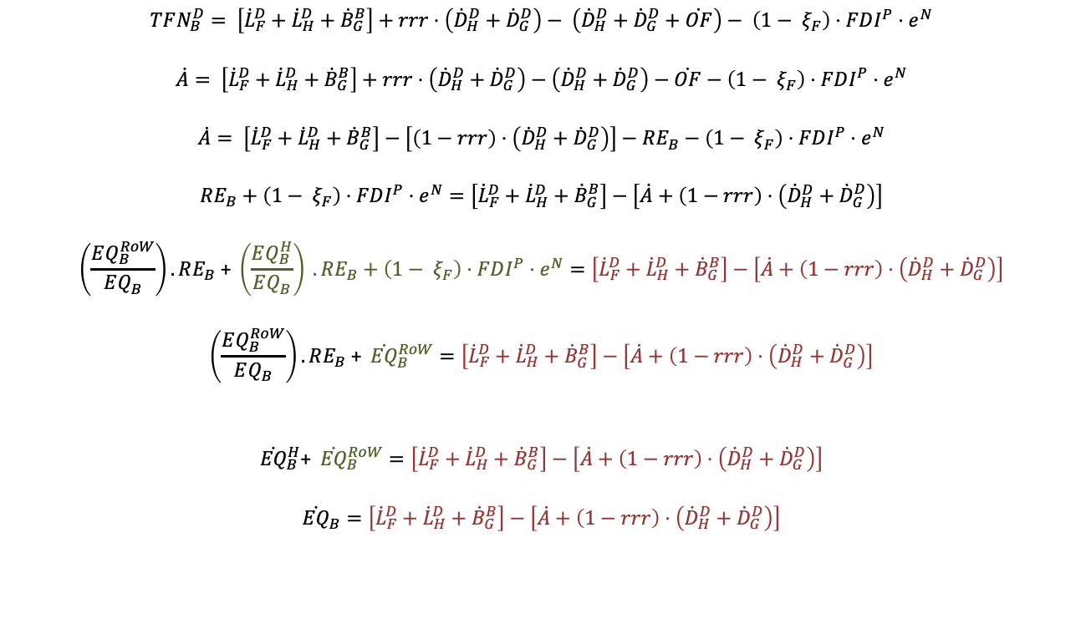
Foreign Firect Investment and shares (Banks)
$$TFN_{B}^{D}= \left[{\dot{L}}_{F}^{D}+{\dot{L}}_{H}^{D}+{\dot{B}}_{G}^{B}\right]+rrr⋅\left({\dot{D}}_{H}^{D}+{\dot{D}}_{G}^{D}\right)− \left({\dot{D}}_{H}^{D}+{\dot{D}}_{G}^{D}+\dot{OF}\right)− \left({1− ξ}_{F}\right)⋅FDI^{P}⋅e^{N}$$
$$\dot{A}= \left[{\dot{L}}_{F}^{D}+{\dot{L}}_{H}^{D}+{\dot{B}}_{G}^{B}\right]+rrr⋅\left({\dot{D}}_{H}^{D}+{\dot{D}}_{G}^{D}\right)−\left({\dot{D}}_{H}^{D}+{\dot{D}}_{G}^{D}\right)−\dot{OF}−\left({1− ξ}_{F}\right)⋅FDI^{P}⋅e^{N}$$
$$\dot{A}= \left[{\dot{L}}_{F}^{D}+{\dot{L}}_{H}^{D}+{\dot{B}}_{G}^{B}\right]−\left[\left(1−rrr\right)⋅\left({\dot{D}}_{H}^{D}+{\dot{D}}_{G}^{D}\right)\right]−RE_{B}−\left({1− ξ}_{F}\right)⋅FDI^{P}⋅e^{N}$$
$$RE_{B}+\left({1− ξ}_{F}\right)⋅FDI^{P}⋅e^{N}=\left[{\dot{L}}_{F}^{D}+{\dot{L}}_{H}^{D}+{\dot{B}}_{G}^{B}\right]−\left[\dot{A}+\left(1−rrr\right)⋅\left({\dot{D}}_{H}^{D}+{\dot{D}}_{G}^{D}\right)\right]$$
$$\left(\frac{EQ_{B}^{RoW}}{EQ_{B}}\right).RE_{B}\text{ +} \left(\frac{EQ_{B}^{H}}{EQ_{B}}\right) .RE_{B}+\left({1− ξ}_{F}\right)⋅FDI^{P}⋅e^{N}=\left[{\dot{L}}_{F}^{D}+{\dot{L}}_{H}^{D}+{\dot{B}}_{G}^{B}\right]−\left[\dot{A}+\left(1−rrr\right)⋅\left({\dot{D}}_{H}^{D}+{\dot{D}}_{G}^{D}\right)\right]$$
$$\left(\frac{EQ_{B}^{RoW}}{EQ_{B}}\right).RE_{B}\text{ +} {\dot{EQ}}_{B}^{RoW}=\left[{\dot{L}}_{F}^{D}+{\dot{L}}_{H}^{D}+{\dot{B}}_{G}^{B}\right]−\left[\dot{A}+\left(1−rrr\right)⋅\left({\dot{D}}_{H}^{D}+{\dot{D}}_{G}^{D}\right)\right]$$
$${\dot{EQ}}_{B}^{H}\text{+} {\dot{EQ}}_{B}^{RoW}=\left[{\dot{L}}_{F}^{D}+{\dot{L}}_{H}^{D}+{\dot{B}}_{G}^{B}\right]−\left[\dot{A}+\left(1−rrr\right)⋅\left({\dot{D}}_{H}^{D}+{\dot{D}}_{G}^{D}\right)\right]$$
$${\dot{EQ}}_{B}=\left[{\dot{L}}_{F}^{D}+{\dot{L}}_{H}^{D}+{\dot{B}}_{G}^{B}\right]−\left[\dot{A}+\left(1−rrr\right)⋅\left({\dot{D}}_{H}^{D}+{\dot{D}}_{G}^{D}\right)\right]$$
$$\dot{A}=TFN_{B}^{D}$$
$${\dot{OF}}_{B}=RE_{B}$$
$${\dot{EQ}}_{B}= {\dot{EQ}}_{B}^{H}+ {\dot{EQ}}_{B}^{RoW}$$
$$RE_{B}\text{=} \left(\frac{EQ_{B}^{RoW}}{EQ_{B}}\right).RE_{B}\text{ +} \left(\frac{EQ_{B}^{H}}{EQ_{B}}\right) .RE_{B}$$

Slide 13
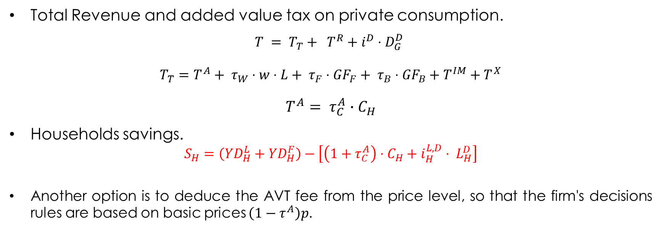
Government.
Total Revenue and added value tax on private consumption.
$$T = T_{T}+ T^{R}+i^{D}⋅D_{G}^{D}$$
$T_{T}=T^{A}+ τ_{W}⋅w⋅L+ τ_{F}⋅{GF}_{F}+ τ_{B}⋅{GF}_{B}+T^{IM}+T^{X}$
$$T^{A}= τ_{C}^{A}∙C_{H}$$
Households savings.
$$S_{H}=\left(YD_{H}^{L}+YD_{H}^{F}\right)−\left[\left(1+τ_{C}^{A}\right)⋅C_{H}+i_{H}^{L,D}⋅ L_{H}^{D}\right]$$
Another option is to deduce the AVT fee from the price level, so that the firm's decisions rules are based on basic prices $\left(1−τ^{A}\right)p$.

Slide 14
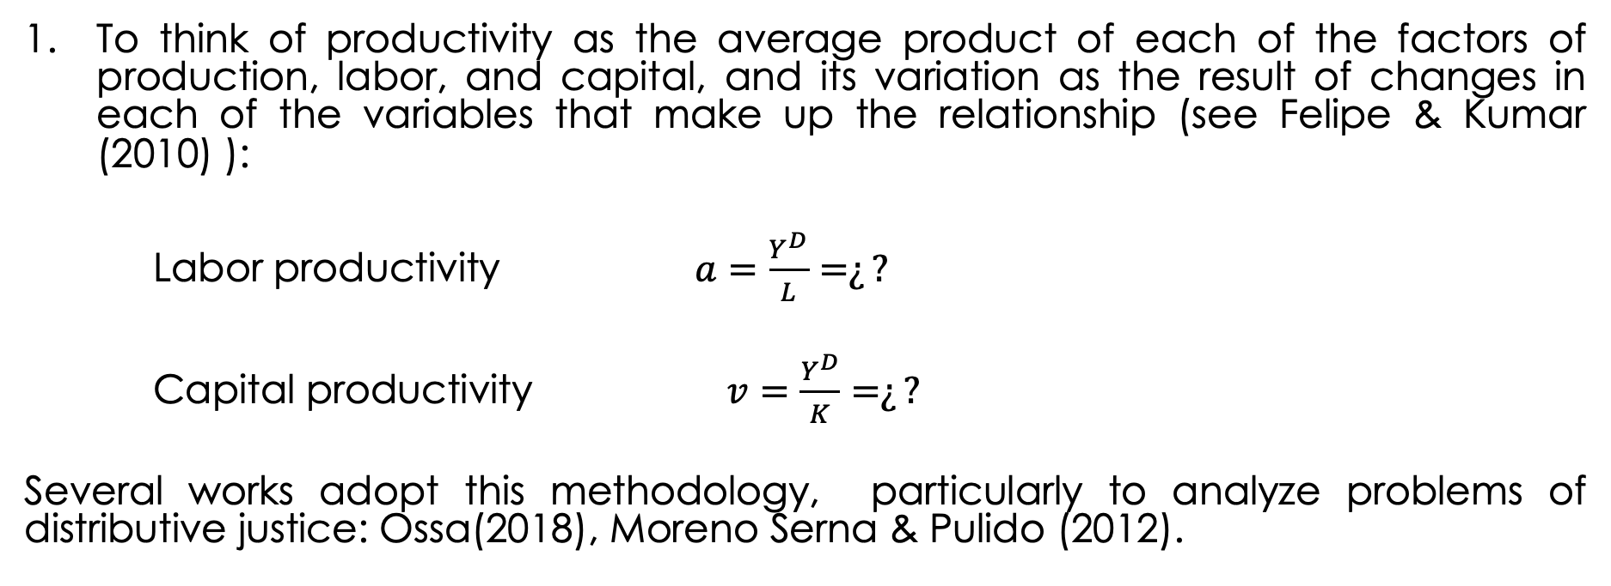
Approaches to defining productivity behaviour:
To think of productivity as the average product of each of the factors of production, labor, and capital, and its variation as the result of changes in each of the variables that make up the relationship (see Felipe & Kumar (2010) ):
Labor productivity $a=\frac{Y^{D}}{L}=¿?$
Capital productivity $v=\frac{Y^{D}}{K}=¿?$
Several works adopt this methodology, particularly to analyze problems of distributive justice: Ossa(2018), Moreno Serna & Pulido (2012).

Slide 15
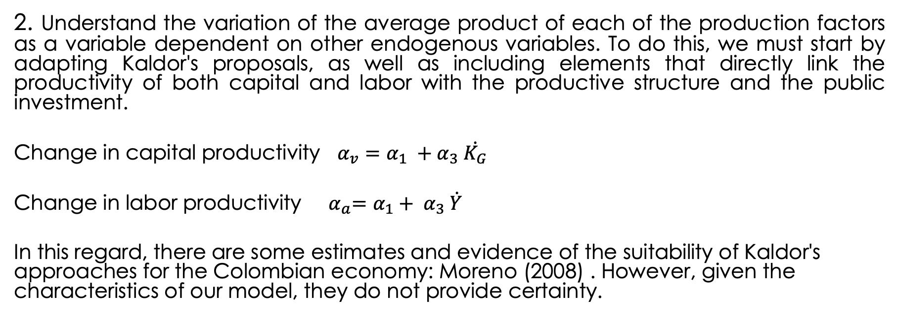
Approaches to defining productivity behaviour:
2. Understand the variation of the average product of each of the production factors as a variable dependent on other endogenous variables. To do this, we must start by adapting Kaldor's proposals, as well as including elements that directly link the productivity of both capital and labor with the productive structure and the public investment.
Change in capital productivity $α_{v}=α_{1} {+ α}_{3}\dot{K_{G}}$
Change in labor productivity${ α}_{a}=α_{1}+ α_{3} \dot{Y}$
In this regard, there are some estimates and evidence of the suitability of Kaldor's approaches for the Colombian economy: Moreno (2008) . However, given the characteristics of our model, they do not provide certainty.

Slide 16

Public Investment.
Public capital accumulation is given by:
$$\dot{K_{G}}=\frac{G_{I}}{p}− δ_{G}⋅K_{G}$$

Slide 17
Summary.
Households loans demand.
Accelerator effect into the investment equation.
Central Bank does not purchase government bonds.
Feedback between labour productivity and public investment.
Government monetary transfers linked to a share of total population.
More detailed tax structure: consumption tax and royalties (proxy)
Autonomous exports.

Slide 18
Summary.
Foreign Direct Investment: added into the investment equation and as a new funding source.
Further modifications to the external sector dynamics:
Credit rationing mechanism in cross border lending flows.
Simpler arbitrage parameters in FX loans demand and portfolio flows.
Exogenous FDI flows.
Exogenous growth rate of remittances.
Possibility of introducing scenarios.

Slide 19
Scenarios.
Benchmark Model:
Foreign policy rate.
World GDP growth rate.
Foreign inflation rate.
Colombian adaptation:
Lower exports and remittances growth.
Lower portfolio and FDI flows.
Greater CBL rationing
Sensitivity analysis.
Exchange rate adjustment.
Fundamentals and risk perception.
Greater households loans elasticity.
Greater sensitivity to arbitrage gaps.
Change in FDI allocation.
Elasticity of productivity to Public Investment.

Slide 20
References.
Camara-Neto, A. F., & Vernengo, M. (2012). Keynes after Sraffa and Kaldor: Effective Demand, Accumulation and Productivity Growth [Chapters]. Edward Elgar Publishing. https://econpapers.repec.org/bookchap/elgeechap/3855_5f10.htm
Dávila-Fernández, M. J. (2020). Alternative approaches to technological change in a small open economy. Journal of Evolutionary Economics, 30(2), 279–317. https://doi.org/10.1007/s00191-019-00658-3
Felipe, J., & Kumar, U. (2010). Technical Change in India’s Organized Manufacturing Sector (SSRN Scholarly Paper ID 1691695). Social Science Research Network. https://doi.org/10.2139/ssrn.1691695
Kaldor, N. (1966). Marginal Productivity and the Macro-Economic Theories of Distribution: Comment on Samuelson and Modigliani. The Review of Economic Studies, 33(4), 309–319. https://doi.org/10.2307/2974428
Moreno Rivas, Á. M. (2008, July 4). Las leyes del desarrollo económico endógeno de Kaldor: El caso colombiano. Revista de Economía Institucional. https://revistas.uexternado.edu.co//index.php/ecoins/article/view/70
Moreno Serna, R., & Pulido, Á. (2012). Tercerización laboral en el sector financiero y evolución salarial en Colombia.
Ossa, D. (2018). Productividad y distribución del ingreso: Implicaciones sobre el salario mínimo colombiano, 2001-2016 | Revista de Economía Institucional. https://revistas.uexternado.edu.co/index.php/ecoins/article/view/5449

